Slide 1

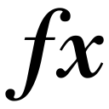

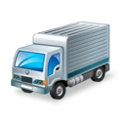



Working Capital “Days”
Trade Receivables
DSO
Clients
Trade Receivables
x
Generated from selling products on credit
360
Revenues
Trade Payables
DPO
Suppliers
Trade Payables
x
360
Generated by the acquisition of Raw Materials from Suppliers
Revenues
Cost of goods sold
Inventory
DIO
Company
Inventory
The amount of goods and finished products held by the company
x
Cost of goods sold
360
Supplier delivers Raw Materials
Products in the company’s warehouse
Raw Materials paid to suppliers
Clients buy the company’s products
Clients pay the products
DPO
DIO
© 365careers, 2014
DSO

